Slide 1
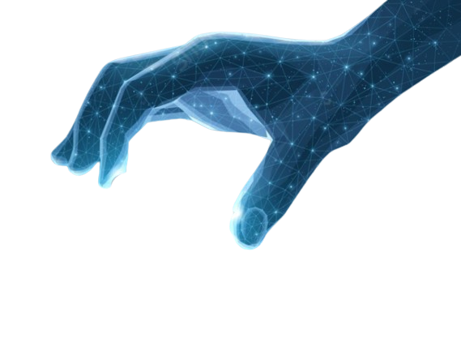


IMAGE AND GRAPHICS
IMD316 | WEEK 4
MOHD AKMAL FAIZ OSMAN

Slide 2
COURSE OUTLINE
Digital Image Representation
Image and Graphic Format
Image Synthesis, analysis, and Transmission
IMAGE AND GRAPHICS
1

Slide 3


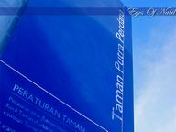
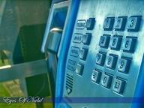

Slide 4

Digital Image Representation
The Makes multimedia application attractive.
Illustrate ideas through image is a very powerful tool in business, marketing, education, medical, engineering, aerospace, etc.
Imported variety resources:
Internet
digital camera
Scanner
Drone
Key feature/element in multimedia products
Most of the time, using text only is not enough to convey a message to the user.

Slide 5
Digital Image Representation
Multimedia products need attractive graphical combination and presentation
Developers must understand the purpose and significance of graphics that are going to be used in their projects
Also important in information delivery
Graphics can be developed using several methods:
Illustration software
Graphic/image manipulation software
Acquiring through scanning or camera transfer
Graphic files can be stored in various file format – each format has different purposes

Slide 6
Type of Graphics
Type of Graphic | Description | Example
Static graphic | Does not show any motion or movement | Image, Logo, Picture
Animated graphic | Collection of static graphics, which change over time to dynamically illustrate a sequence or process
Conceptual graphic | Used to explain a concept , idea, theory or impression that cannot be seen | A graphic depicting data transfer between two computers
Screenshots or screen grabs | Generally used in courses based on software applications | A course on Microsoft word can include screen grabs to show how to perform various tasks in Word, such as opening a document, saving

Slide 7


To create a remarkable graphics, developer must understand graphics and its elements:
Lines
Shapes
Space
Texture
Color

Slide 8
LINES
A mark with length and directions
Continuous mark made on some surface by a moving point
Types of line include: vertical, horizontal, diagonal, straight or ruled, curved, bent, angular, etc

Slide 9
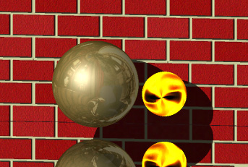
SHAPES
Enclosed space defined and determined by other art elements such as line, color, value, and texture
Can appear as 2 dimensional (2D) or 3 dimensional (3D)

Slide 10
SPACES
Refers to the distance or area between, around, above, below, or within things
can be described as two-dimensional or three-dimensional; as flat, shallow or as positive or negative space etc

Slide 11

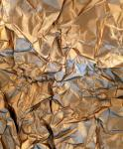
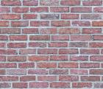
TEXTURE
Surface quality or "feel" of an object, its smoothness, roughness, softness, etc
Actual or Simulated

Slide 12
IMAGE SYNTHESIS, ANALYSIS, & TRANSMISSION
The process of converting the input text, sketch, or other sources, i.e., another image or mask, into an image
Means to generate artificial images from various input forms, i.e.,text, sketch, audio, or another image
Plays a significant role in many practical applications, i.e., art generation, computer-aided design photo-editing, photo inpainting, education, human–computer interaction, and security
Has recently become a hot topic with growing interest from researchers

Slide 13
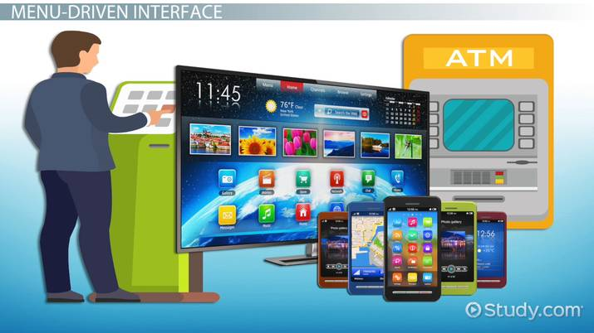
IMAGE SYNTHESIS
Image synthesis deals with the generation of images of real or imaginary objects.
It is an integral part of all computer user interfaces and is indispensable for visualizing 2D, 3D and higher dimensional objects.
Some of the applications of image synthesis (areas which use image synthesis) are: -
User Interface :-
Point-and-click facility
Menu-driven

Slide 14

Office automation and electronic publishing
Desktop publishing
Electronic publishing
Hypermedia Systems
Simulation and Animation for Scientific Visualization and Entertainment
Simulation of real time systems
Visualization of time-varying behavior of systems
Abstract representation of complex mathematical expressions
Models for fluid flow, chemical reaction etc.
Cartoons
Flying logos and more exciting visual for movies

Slide 15
The End of Chapter 4
akmalfaiz@uitm.edu.my
School of Information Science,
College of Computing, Informatics and Mathematics
Universiti Teknologi MARA (UiTM)

